Slide 1
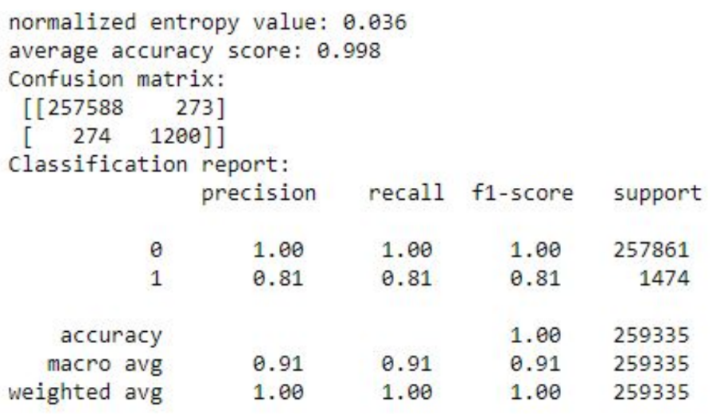
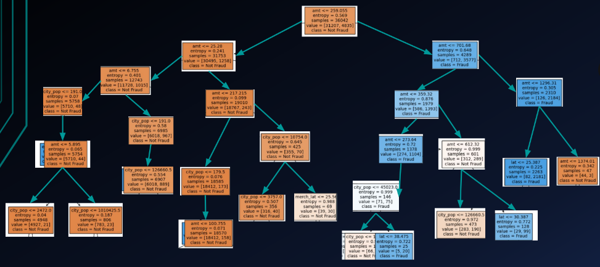
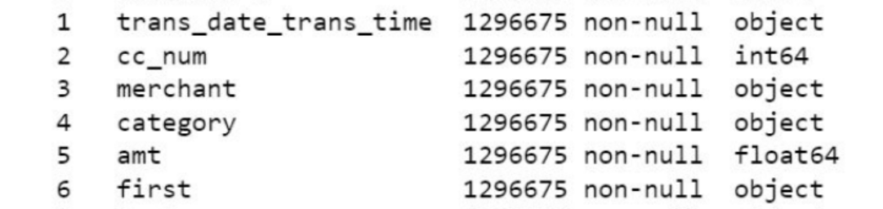
Developing a Supervised Machine Learning Model for Credit Card Fraud Detection
Highlights
Global card fraud losses amounted to $27.85 billion in 2018, which was an increase of 18.4% from the previous year. (Harrison, 2021)
A decision tree is created by analyzing historical data of both fraudulent and non-fraudulent transactions.
The average accuracy score of 0.998 indicates the model is highly accurate.
Author 1, Author 2, Author 3
Background
Credit card fraud is a serious issueaffecting financial institutions and consumers worldwide.
Global card fraud losses amounted to $27.85 billion in 2018, which was an increase of 18.4% from the previous year (Harrison, 2021).
In 2019, consumers reported losing over $1.9 billion to fraud (FTC, 2020).
Financial institutions are also impacted,with billions of dollars lost globally each year.
The consequences of credit card fraud can be severe, leading to financial losses and damage to credit scores.
Model
A decision tree is a type of supervised learning algorithm that is used for both regression and classification tasks and uses a tree-like structure to represent decisions and their consequences. (Breiman et al. 10)
Model is created by analyzing historical data of both fraudulent and non-fraudulent transactions.
The algorithm uses this model to predict whether a new transaction is likely to be fraud or not.
Results
Training
Code splits the dataset into predictor variables (X) and the target variable (y) where 'is_fraud' is the target variable.
Next, the code trains the decision tree model with 80% of the data using the 'entropy' criterion (Pedregosa et al. 2011).
Finally, the code prints the normalized entropy value, the average accuracy score, the confusion matrix, and the classification report.
Data
For the model we selected Dermisfit Fraud transactions dataset from Kaggle.
This public dataset provides a large and diverse collection of transactions that have been flagged as either fraudulent or non-fraudulent. The dataset has been used by researchers and practitioners who are interested in developing fraud detection models.
The data set is fictional and is trying to simulate real-life details. contains 1,048,576 records in 23 columns.
The normalized entropy value of 0.036 indicates the model is relatively consistent and stable in its performance.
The average accuracy score of 0.998 indicates the model is highly accurate.
F-Score of 0.91.
Next Steps
Work with actual credit card transaction data and evaluate the model's performance over different time periods.

